Slide 1

SPL Final Project :Kotlin
Vishwas Viswanath Banjan
Karthik Raveendran
Maksim Mozhelyuk
Sanchari Chatterjee
Chris Malang

Slide 2
Language Paradigm
Object Oriented Programming
Functional Programming
Simplistic approach
Notes:
While object-oriented programming traces its foundational structure on the bases of object creation, functional programming provides a more transparent approach as it alleviates stress during evaluation. As a result, adopting the functional paradigm allows for numerous benefits such as debugging and comprehending code can become more simplistic while still maintaining a level of complexity. OOP (object-Oriented Programming) on the other hand takes a more stateful programming model. It’s advantages span from having a clear modular structure to the ability to reuse objects that have already been created. This, as a result, drops overall costs during the development process. Kotlin utilizes both OOP as well as functional programming which ultimately, creates the ability for developers to have options when programming.

Slide 3
Historical Overview
Introduced in July 2011
Developed by JetBrains
Google I/O 2019 announcement
Notes:
Introduced in 2011 as a public project and then later in February 15, 2016, JetBrains officially announced there stable release of version 1.0
JetBrains developers
As a result, on May 7, 2019, Google I/O officially announced that their preferred language of choice in Android application development was in fact Kotlin

Slide 4
Benefits of Kotlin
Runs on JVM
Syntax Concise & Reduce Vibrosity
Easily Maintainable
Notes:
Directly, compatible with Java Code (Both compile to bytecode in the same manner)
Designers to Java and improved upon it which as a result made syntax more concise
Kotlin is supported by a vast majority of IDEs, including Android Studio, and other SDK tools. This helps increase developers’ productivity, as they can continue to work with the toolkit they are used to.

Slide 5
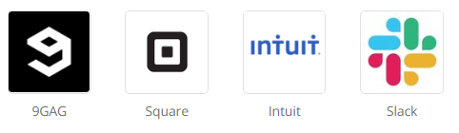

Who Uses Kotlin
Notes:
Directly, compatible with Java Code (Both compile to bytecode in the same manner)
Designers to Java and improved upon it which as a result made syntax more concise
Kotlin is supported by a vast majority of IDEs, including Android Studio, and other SDK tools. This helps increase developers’ productivity, as they can continue to work with the toolkit they are used to.

Slide 6
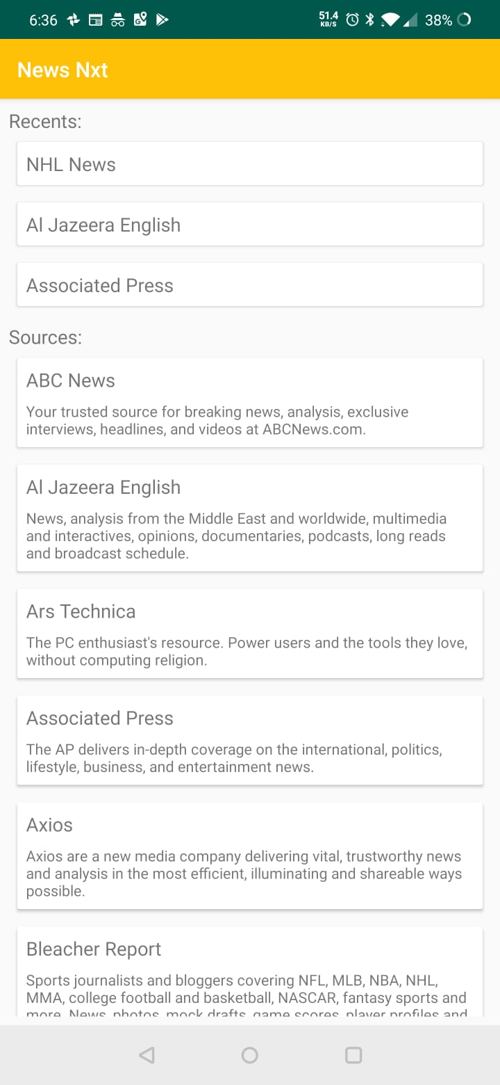
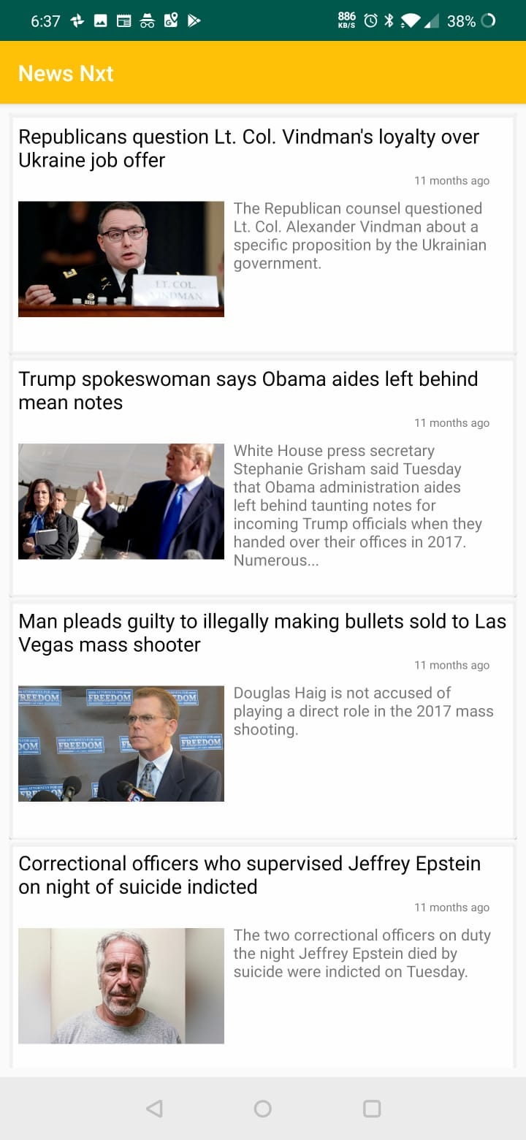
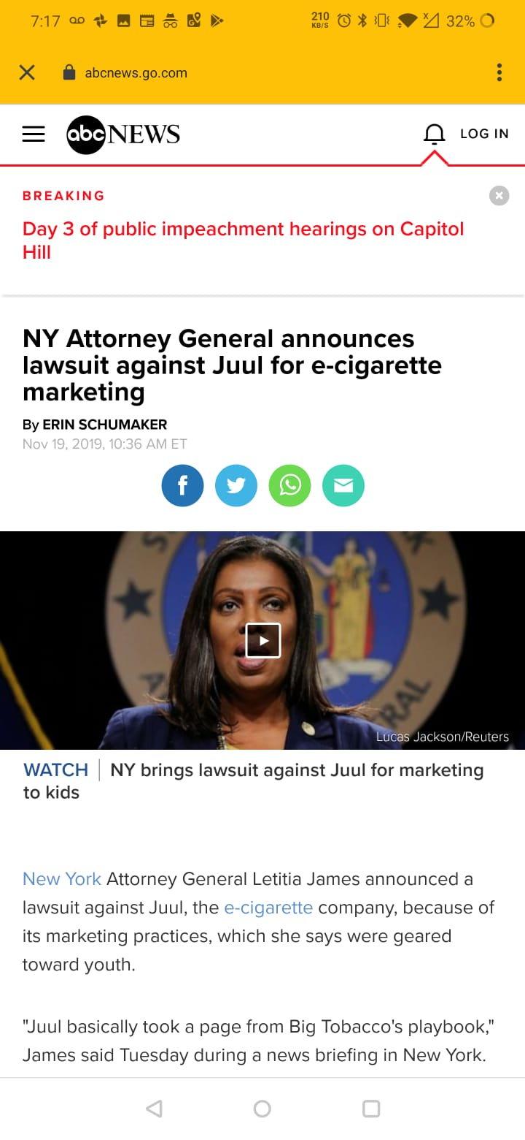
Future Scope
We want to require a user profile to be created in order to assist with personalization and catering to each user and their preferences.
A Profile settings page to change country, language and sources whenever the user prefers.
A feature that the enables the user to compare between two different news sources.

Slide 7
References
https://kotlinlang.org/docs/reference/faq.html
https://blog.jetbrains.com/kotlin/
https://www.infoworld.com/article/2622405/jetbrains-readies-jvm-based-language.html
https://codelabs.developers.google.com/android-kotlin-fundamentals/
https://codelabs.developers.google.com/kotlin-bootcamp/

